Slide 1





“If you want to build a ship, don’t drum up people together to collect wood and don’t assign them tasks and work, but rather teach them to long for the endless immensity of the sea.” —Antoine de Saint-Exupéry
Then give them the tools to thrive!
Begin your journey

Slide 2

HyphaEARTH
Co-create the next chapter in Earth’s history
Begin your journey
Notes:
Pulsating effect on button - https://www.amcharts.com/demos/map-with-pulsating-bullets/
https://codepen.io/joachimstroh/pen/VwvXNyV

Slide 3



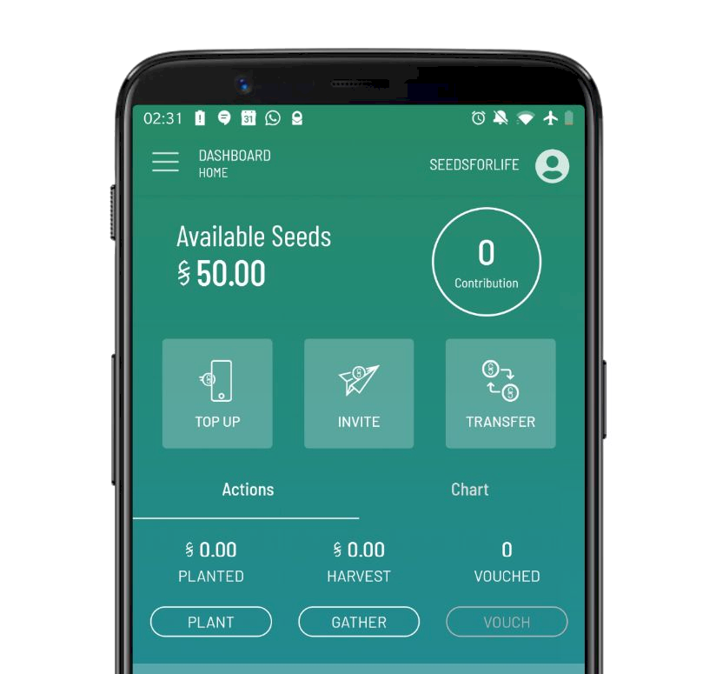





HyphaEARTH / Begin your Journey
Become a Citizen
Download your SEEDS passport to a regenerative society, learn about the movement and start healing our planet.
Join or Create an Organization
A DHO - Decentralized Human Organization - take advantage of decentralized toolsets & protocols.
APPLY NOW
Organization
Terra Agora Foundation
Note: follow the green circle as we explore the the platform!
Download
OPEN
Browse
Join or Create a Village
Find your tribe! Co-create a new way of life, explore a new culture or community. Here you see all the villages, retreats and projects.
Join or Create a Bioregion
Find your ecological niche, connect with local neighbourhoods and indigenous communities and strengthen customs, people and traditions.
JOIN NOW
JOIN NOW
Village Peace Town
Bioregion
Arctic Basin
Browse
APPLY
Browse
JOIN
Notes:
Begin your journey
Become a SEEDS Citizen
Download your passport to a regenerative society, learn about our movement and start healing the planet.
Become a SEEDS Ambassador
Represent our global movement for regenerating the environment and allocate money to fund community proposals and more.
Become an Ally
Join a global alliance, access new income streams, connect with incentivized users and thrive together.
Join the Hypha Core Team
Bring your talents to fruition with a global team of professionals and build the next generation of human-centered decentralized tools and services.
Join a Hypha Bioregion
Find your ecological niche, connect with local neigbourhoods and indiginuous communities and strengthen customs, people and traditions.

Slide 4
HyphaEARTH / Create a New Village
What is the name of your [village]?
Enter Name
Continue
Notes:
Begin your journey
Become a SEEDS Citizen
Download your passport to a regenerative society, learn about our movement and start healing the planet.
Become a SEEDS Ambassador
Represent our global movement for regenerating the environment and allocate money to fund community proposals and more.
Become an Ally
Join a global alliance, access new income streams, connect with incentivized users and thrive together.
Join the Hypha Core Team
Bring your talents to fruition with a global team of professionals and build the next generation of human-centered decentralized tools and services.
Join a Hypha Bioregion
Find your ecological niche, connect with local neigbourhoods and indiginuous communities and strengthen customs, people and traditions.

Slide 5
HyphaEARTH / Create a New Village
Do you want to create a unique ownership/access token?
Official Token Name
12 characters a-z start with letter and only numbers 1-5
Max Quantity (If required)
No - keep going
Yes - create
Notes:
Begin your journey
Become a SEEDS Citizen
Download your passport to a regenerative society, learn about our movement and start healing the planet.
Become a SEEDS Ambassador
Represent our global movement for regenerating the environment and allocate money to fund community proposals and more.
Become an Ally
Join a global alliance, access new income streams, connect with incentivized users and thrive together.
Join the Hypha Core Team
Bring your talents to fruition with a global team of professionals and build the next generation of human-centered decentralized tools and services.
Join a Hypha Bioregion
Find your ecological niche, connect with local neigbourhoods and indiginuous communities and strengthen customs, people and traditions.

Slide 6
HyphaEARTH / Create a New Village
Do you want to create a unique voice/governance token?
Official Token Name
12 characters a-z start with letter and only numbers 1-5
No - keep going
Yes - create
Notes:
Begin your journey
Become a SEEDS Citizen
Download your passport to a regenerative society, learn about our movement and start healing the planet.
Become a SEEDS Ambassador
Represent our global movement for regenerating the environment and allocate money to fund community proposals and more.
Become an Ally
Join a global alliance, access new income streams, connect with incentivized users and thrive together.
Join the Hypha Core Team
Bring your talents to fruition with a global team of professionals and build the next generation of human-centered decentralized tools and services.
Join a Hypha Bioregion
Find your ecological niche, connect with local neigbourhoods and indiginuous communities and strengthen customs, people and traditions.

Slide 7
HyphaEARTH / Create a New Village
Which accounts can approve new members to your village?
Account 1 (Required)
Add more
Continue
Notes:
Begin your journey
Become a SEEDS Citizen
Download your passport to a regenerative society, learn about our movement and start healing the planet.
Become a SEEDS Ambassador
Represent our global movement for regenerating the environment and allocate money to fund community proposals and more.
Become an Ally
Join a global alliance, access new income streams, connect with incentivized users and thrive together.
Join the Hypha Core Team
Bring your talents to fruition with a global team of professionals and build the next generation of human-centered decentralized tools and services.
Join a Hypha Bioregion
Find your ecological niche, connect with local neigbourhoods and indiginuous communities and strengthen customs, people and traditions.

Slide 8







HyphaEARTH / Create a New Village
Where does your Village exist?
Input Location

Slide 9
HyphaEARTH / Create a New Village
Congratulations! Here’s your new Village Card!
Click the image and words to edit.
JOIN NOW
Village Artesia
Open
Continue
Notes:
Begin your journey
Become a SEEDS Citizen
Download your passport to a regenerative society, learn about our movement and start healing the planet.
Become a SEEDS Ambassador
Represent our global movement for regenerating the environment and allocate money to fund community proposals and more.
Become an Ally
Join a global alliance, access new income streams, connect with incentivized users and thrive together.
Join the Hypha Core Team
Bring your talents to fruition with a global team of professionals and build the next generation of human-centered decentralized tools and services.
Join a Hypha Bioregion
Find your ecological niche, connect with local neigbourhoods and indiginuous communities and strengthen customs, people and traditions.

Slide 10
Global Villages

Slide 11




Villages
Artesia Village
Transformation Exp.
Permaculture Retreat
Eco Village
Natural Building Land
Organic Cooperative
Wizard/Witch Town
Villages / Join a Village
Explore
Explore
Explore
Member!
JOIN NOW
Village
Tamarindo
Village
Panajachel
Village
Marvão
Village Artesia
JOIN
JOIN
JOIN
OPEN
Notes:
https://www.iconbolt.com/iconsets/font-awesome-solid/handshake
https://www.countryflags.com/en/portugal-flag-icon.html

Slide 12
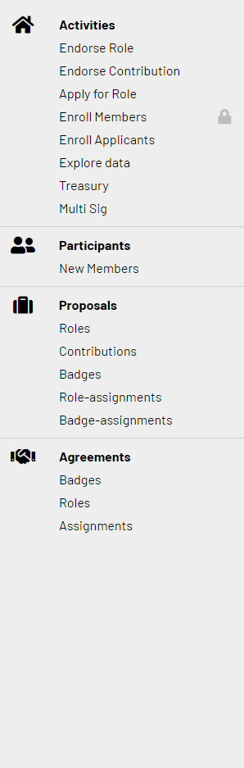


Artesia Village / Dashboard
Good morning, Artesian. What would you like to do today?
Create or Endorse Proposals
Co-create Artesia.
Review current funding proposals and decide which ones you like to endorse. New proposals are are open for voting for a period of 2 weeks.
Enroll Villagers
Review current registrants and decide which ones you feel would be a good fit for Artesia. Our trust protocols requires at least 3 villagers vouch for new members.
APPLYING
1
PROPOSING
APPLYING
Contribute
Villagers
ENDORSE
VOUCH
Apply for a Quest or Role
Review open quests and roles and decide if you want to apply (you can always commit to a partial role).
Claim Your Artesian Share
Claim your rewards at the end of each lunar cycle. You can do many assignments, quests and contributions.
There is 1 salary you can claim.
NOW HIRING
NOW PAYING
Quests & Roles
Assignments Gardener
APPLY
CLAIM
Notes:
Purchase Village Shares (for https://www.iconbolt.com/iconsets/font-awesome-solid/handshake

Slide 13
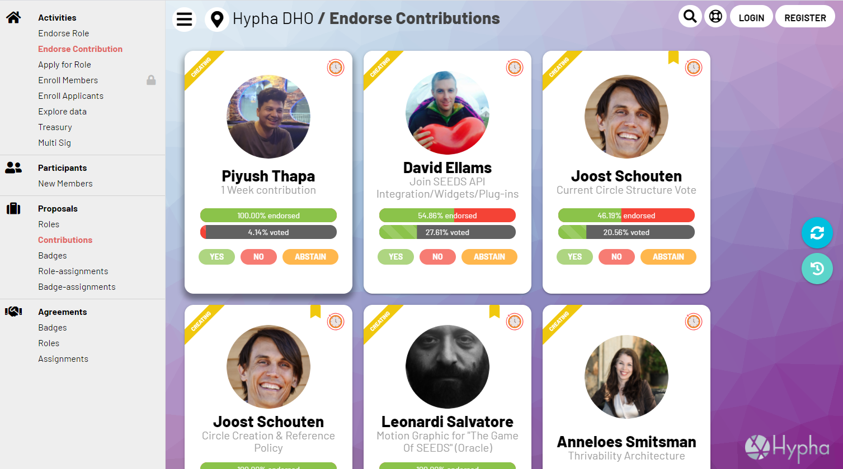


Slide 14
Artesia Village / Dashboard
Good morning, Artesian. What would you like to do today?
Create or Endorse Proposals
Co-create Artesia.
Review current funding proposals and decide which ones you like to endorse. New proposals are are open for voting for a period of 2 weeks.
Enroll Villagers
Review current registrants and decide which ones you feel would be a good fit for Artesia. Our trust protocols requires at least 3 villagers vouch for new members.
APPLYING
1
PROPOSING
APPLYING
Contribute
Villagers
ENDORSE
VOUCH
Apply for a Quest or Role
Review open quests and roles and decide if you want to apply (you can always commit to a partial role).
Claim Your Artesian Share
Claim your rewards at the end of each lunar cycle. You can do many assignments, quests and contributions.
There is 1 salary you can claim.
NOW HIRING
NOW PAYING
Quests & Roles
Assignments Gardener
APPLY
CLAIM
Notes:
Purchase Village Shares (for https://www.iconbolt.com/iconsets/font-awesome-solid/handshake

Slide 15
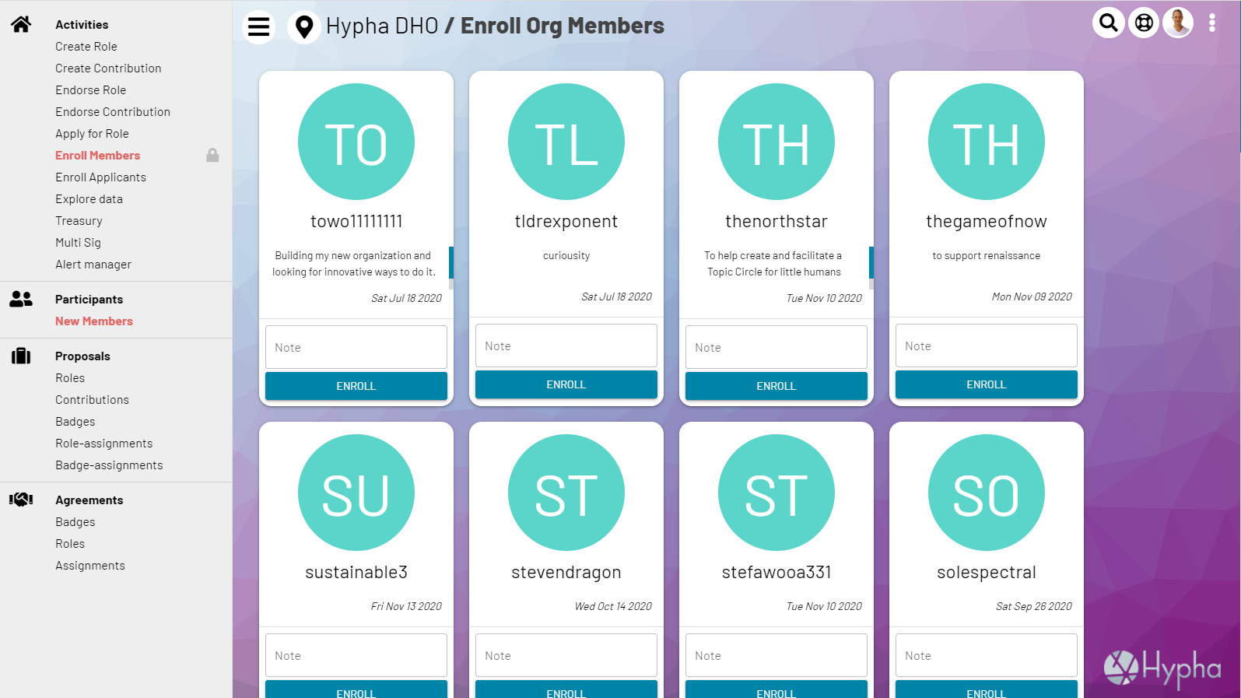
1
Notes:
Purchase Village Shares (for https://www.iconbolt.com/iconsets/font-awesome-solid/handshake

Slide 16
Artesia Village / Dashboard
Good morning, Artesian. What would you like to do today?
Create or Endorse Proposals
Co-create Artesia.
Review current funding proposals and decide which ones you like to endorse. New proposals are are open for voting for a period of 2 weeks.
Enroll Villagers
Review current registrants and decide which ones you feel would be a good fit for Artesia. Our trust protocols requires at least 3 villagers vouch for new members.
APPLYING
1
PROPOSING
APPLYING
Contribute
Villagers
ENDORSE
VOUCH
Apply for a Quest or Role
Review open quests and roles and decide if you want to apply (you can always commit to a partial role).
Claim Your Artesian Share
Claim your rewards at the end of each lunar cycle. You can do many assignments, quests and contributions.
There is 1 salary you can claim.
NOW HIRING
NOW PAYING
Quests & Roles
Assignments Gardener
APPLY
CLAIM
Notes:
Purchase Village Shares (for https://www.iconbolt.com/iconsets/font-awesome-solid/handshake

Slide 17
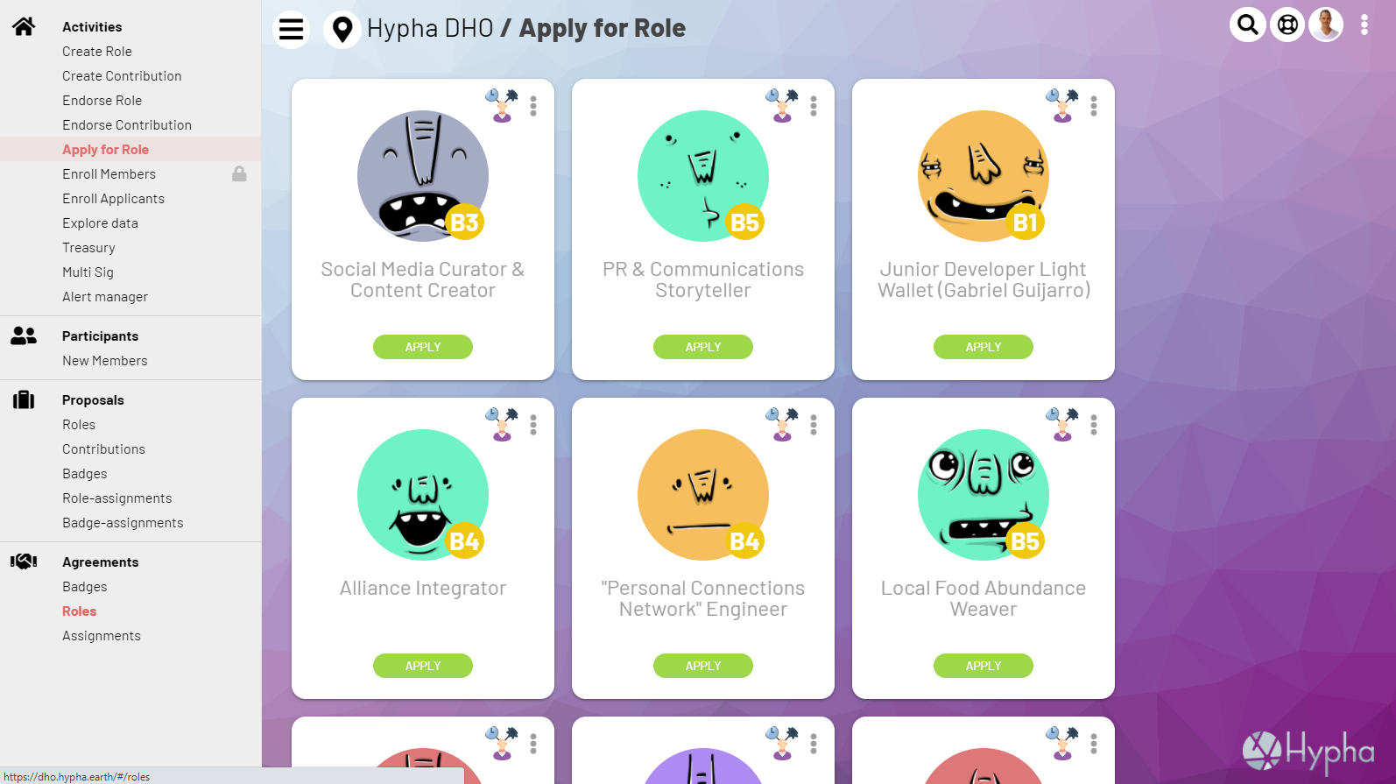

Slide 18
Artesia Village / Dashboard
Good morning, Artesian. What would you like to do today?
Create or Endorse Proposals
Co-create Artesia.
Review current funding proposals and decide which ones you like to endorse. New proposals are are open for voting for a period of 2 weeks.
Enroll Villagers
Review current registrants and decide which ones you feel would be a good fit for Artesia. Our trust protocols requires at least 3 villagers vouch for new members.
APPLYING
1
PROPOSING
APPLYING
Contribute
Villagers
ENDORSE
VOUCH
Apply for a Quest or Role
Review open quests and roles and decide if you want to apply (you can always commit to a partial role).
Claim Your Artesian Share
Claim your rewards at the end of each lunar cycle. You can do many assignments, quests and contributions.
There is 1 salary you can claim.
NOW HIRING
NOW PAYING
Quests & Roles
Assignments Gardener
APPLY
CLAIM
Notes:
Purchase Village Shares (for https://www.iconbolt.com/iconsets/font-awesome-solid/handshake

Slide 19
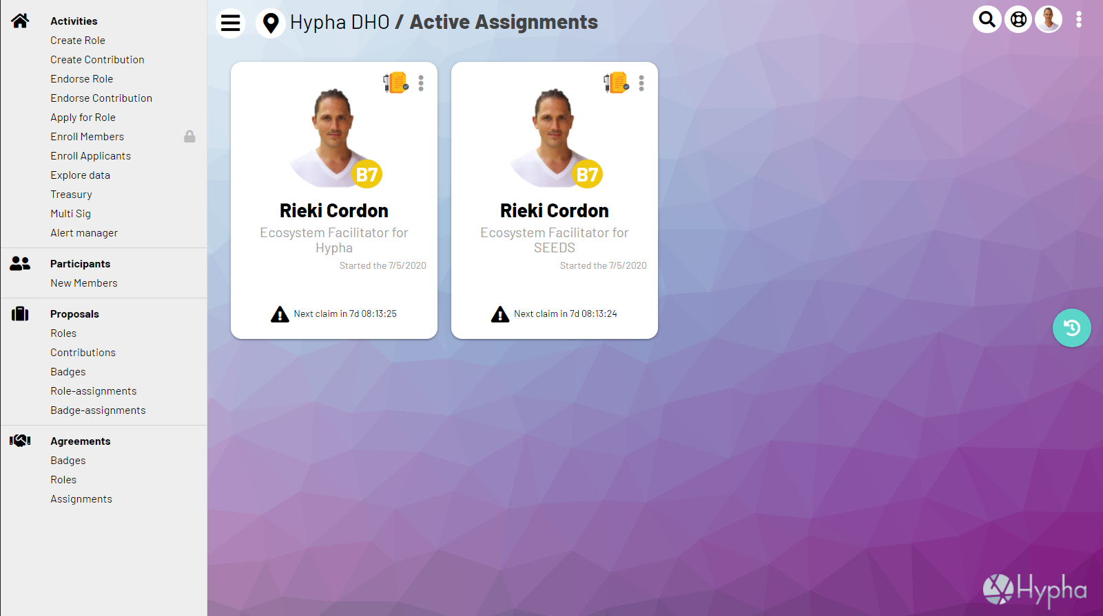

Slide 20
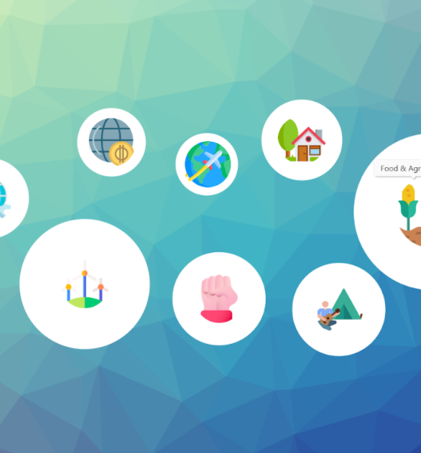



Artesia Village / Dashboard
Good morning, Artesian. What would you like to do today?
Create or Vote on Referendums
Review current governance proposals and take part in shaping the evolution of Artesia. New proposals are are open for voting for a period of 2 weeks.
Purchase Artesia Village Shares
Buy access and a share of Artesia!
SHARES
1
PROPOSING
APPLYING
Govern
Village Shares
VOTE
GET
View Village Map
View the active roles, quests, villages, groups, businesses and organisations within Artesia.
View Village Tools
Access all the coordination tools used by Artesia.
Calendar
Hypha Calendar
VIEW
Expand
Notes:
Purchase Village Shares - https://www.iconbolt.com/iconsets/font-awesome-solid/handshake

Slide 21


Artesia Village / Get Shares
How Exciting! Grow your share of Artesia!
FROM
Balance: 10,050
OPEN WALLET
0.0 (enter amount)
Select which currency you want to use. Click here for further options!
Seeds
Exchange Details
Current (local currency) Rate: $333.01 (+13%) Seeds (selected currency) Rate:
S275.75 (-1%)
SELECT YOUR CURRENCY
TO
Balance: 111
0.0
This is how many Artesia Tokens you’re purchasing.
TRADE
Open Wallet

Slide 22
Artesia Village / Dashboard
Good morning, Artesian. What would you like to do today?
Create or Vote on Referendums
Review current governance proposals and take part in shaping the evolution of Artesia. New proposals are are open for voting for a period of 2 weeks.
Purchase Artesia Village Shares
Buy access and a share of Artesia!
SHARES
1
PROPOSING
APPLYING
Govern
Village Shares
VOTE
GET
View Village Map
View the active roles, quests, villages, groups, businesses and organisations within Artesia.
View Village Tools
Access all the coordination tools used by Artesia.
Calendar
Hypha Calendar
VIEW
Expand
Notes:
Purchase Village Shares - https://www.iconbolt.com/iconsets/font-awesome-solid/handshake

Slide 23
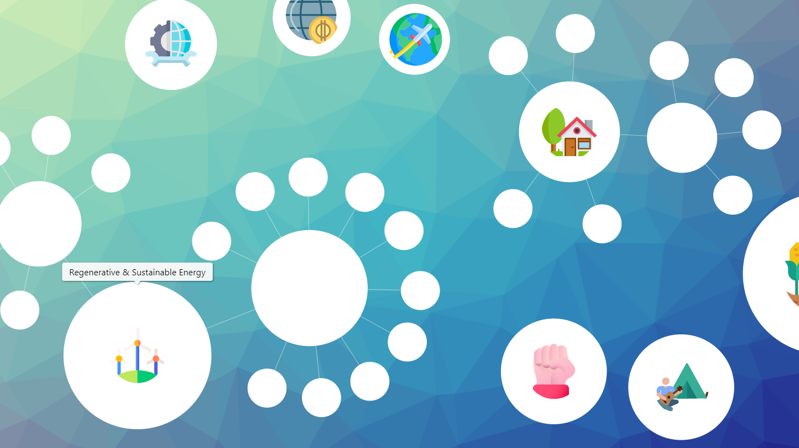
Village Map
1
Notes:
https://codepen.io/joachimstroh/pen/abvYdZE?editors=0110
https://www.amcharts.com/demos/collapsible-force-directed-tree/
https://www.amcharts.com/docs/v4/chart-types/force-directed/
https://medium.com/joinseeds/join-the-pledge-for-global-regeneration-36233c460e2c
series.minRadius = 15
series.maxRadius = 40
series.colors.list = [
am4core.color("#F42B03"),
am4core.color("#D84A05"),
am4core.color("#EC7505"),
am4core.color("#E89005")
];

Slide 24
Artesia Village / Dashboard
Good morning, Artesian. What would you like to do today?
Create or Vote on Referendums
Review current governance proposals and take part in shaping the evolution of Artesia. New proposals are are open for voting for a period of 2 weeks.
Purchase Artesia Village Shares
Buy access and a share of Artesia!
SHARES
1
PROPOSING
APPLYING
Govern
Village Shares
VOTE
GET
View Village Map
View the active roles, quests, villages, groups, businesses and organisations within Artesia.
View Village Tools
Access all the coordination tools used by Artesia.
Calendar
Hypha Calendar
VIEW
Expand
Notes:
Purchase Village Shares - https://www.iconbolt.com/iconsets/font-awesome-solid/handshake

Slide 25









Hypha / Tools
Chart
Doughnut Economics
Zoom
Video Conferencing
Hubspot
CRM, Alliance & Mktg Flows
Asana
Task Management
DHO
Governance & Pay
JOIN
JOIN
JOIN
OPEN
OPEN
Telegram
SEEDS Community
GDrive
Bioregion Documents
Calendar
Hypha Calendar
Gitlab
Code Development
Peeranha
Telos Stack Overflow Q&A
OPEN
VIEW
VIEW
OPEN
OPEN

Slide 26
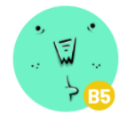


Artesia Village / Village Gratitude News Feed
Villager @villagename - Jan 1 Hey everyone! Inspired to plant a few fruit trees along “Lovers Lane” today! #regeneration #plantingtrees
By clicking the heart you’re sending “Gratitude Tokens” which gives the person a share of Artesia’s “ Gratitude Fund”
Villager 2 @village2name - Jan 1 What a day!!!

Slide 27


Artesia Village / Village Inter-Exchange
How Exciting, get a share of businesses in your village!
FROM
Balance: 10,050
OPEN WALLET
0.0 (enter amount)
Select which currency you want to use. Click here for further options!
Seeds
Exchange Details
Current (local currency) Rate: $333.01 (+13%) Seeds (selected currency) Rate:
S275.75 (-1%)
SELECT YOUR CURRENCY
TO
Balance: 111
0.0
This is how many Meadow (Restaurant) Tokens you’re purchasing.
Meadow
TRADE
SELECT THE TOKEN

Slide 28
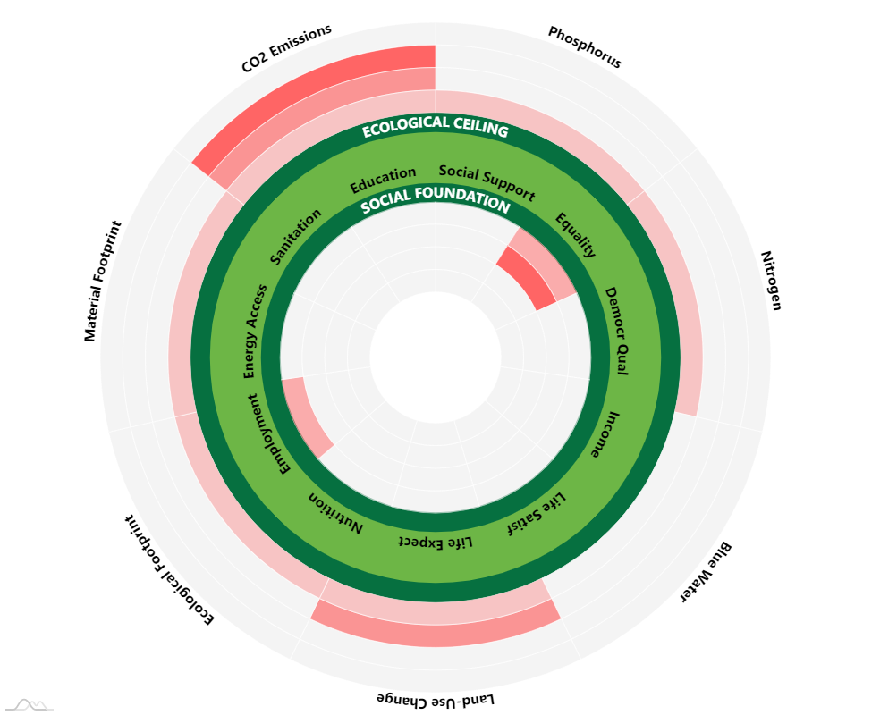
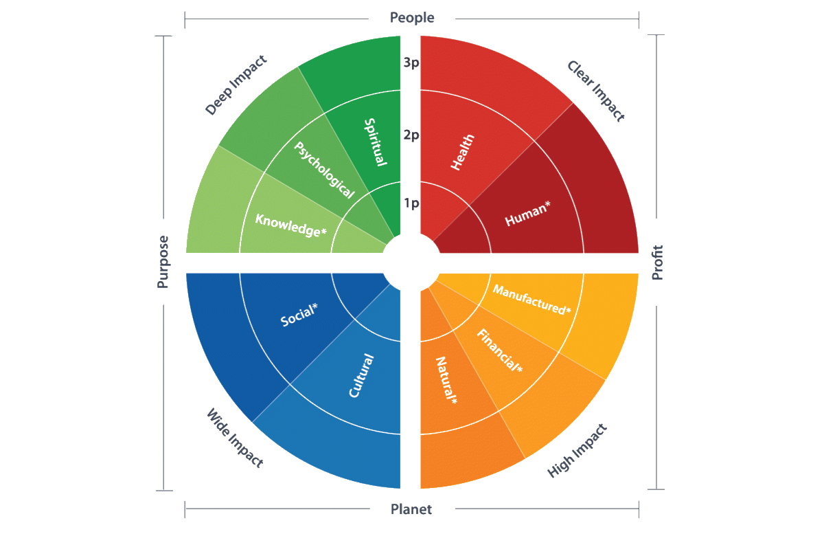
Toolsets / Artesia Village Health
1
Notes:
https://www.iconbolt.com/iconsets/font-awesome-solid/handshake

Slide 29
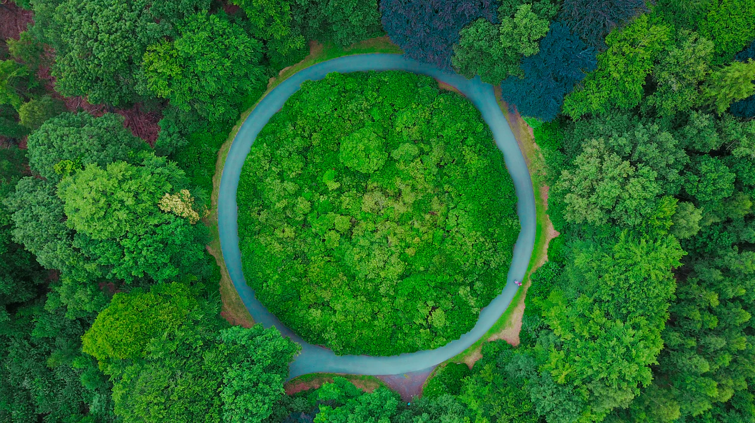





Village
Ontology
Organizational Evolution
Regenerative Living
Regenerative Education
Regenerative Forestation
DHO
Regenerative
Health
Regenerative Agriculture
Regenerative Finance
Notes:
https://medium.com/activate-the-future/what-is-regenerative-behaviour-47bb0f6b0bbe
https://earthwatch.org.uk/working-with-business/tiny-forests
http://regenerosity.com/ - Regenerosity is a system for recognition of voluntary service, philanthropy & gift, civic engagement, trade, commerce, work, and any other contributions to the health and wealth of our communities. If you are a member of any community, whether as a person, as a non-profit organization, or as a for-profit business, there is something in it for you. As a person, you receive recognition for voluntarism, philanthropy, civic service, and many other types of community-building participation. As a non-profit organization, you receive tools for volunteer & donor recognition and access to untapped sources of support. As a for-profit business, you receive tools for customer loyalty & econometrics and access to untapped sources of working capital. As a school, you receive interactive tools for teaching economics & civics and for promoting community service. Everyone receives tools for measurement and analysis of social capital (their own and that of their communities) and practical tools to build community self-reliance and sustainable local economy, including community-based mutual credit systems.

Slide 30
The Separation of Voice and Wealth
Revenue Sharing Token
New Tokens!
Voice/Voting Token

Slide 31
Currency Diversity
Village 2
Village 3
Village 1
Inter-Whole Currency
Intra-Whole Currency
Notes:
Inter comm currencies needed to coordinate large projects. Clean pacific garbage patch, etc.

Slide 32
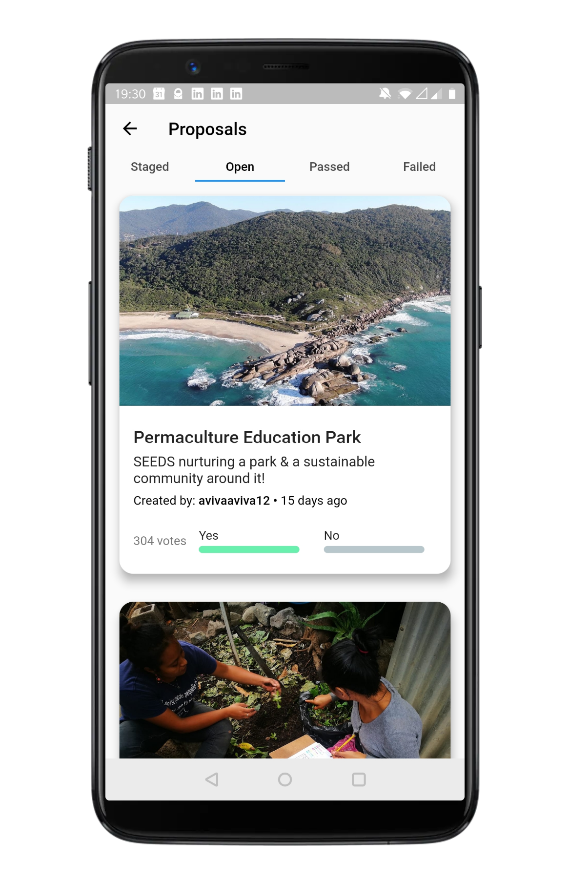
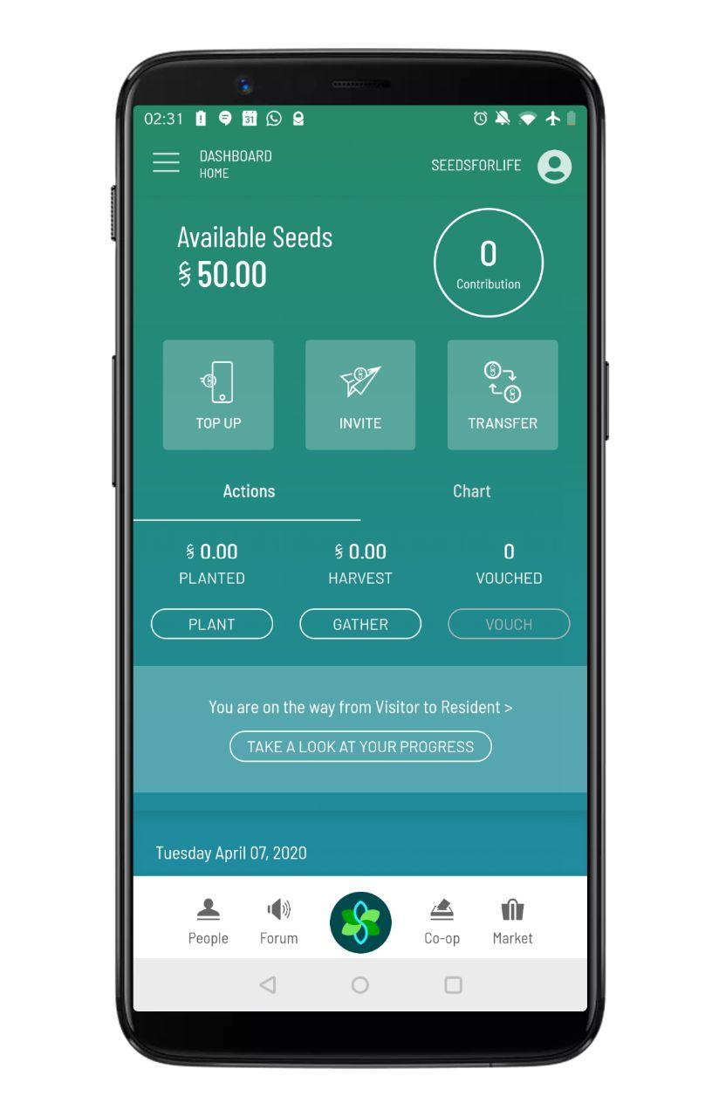
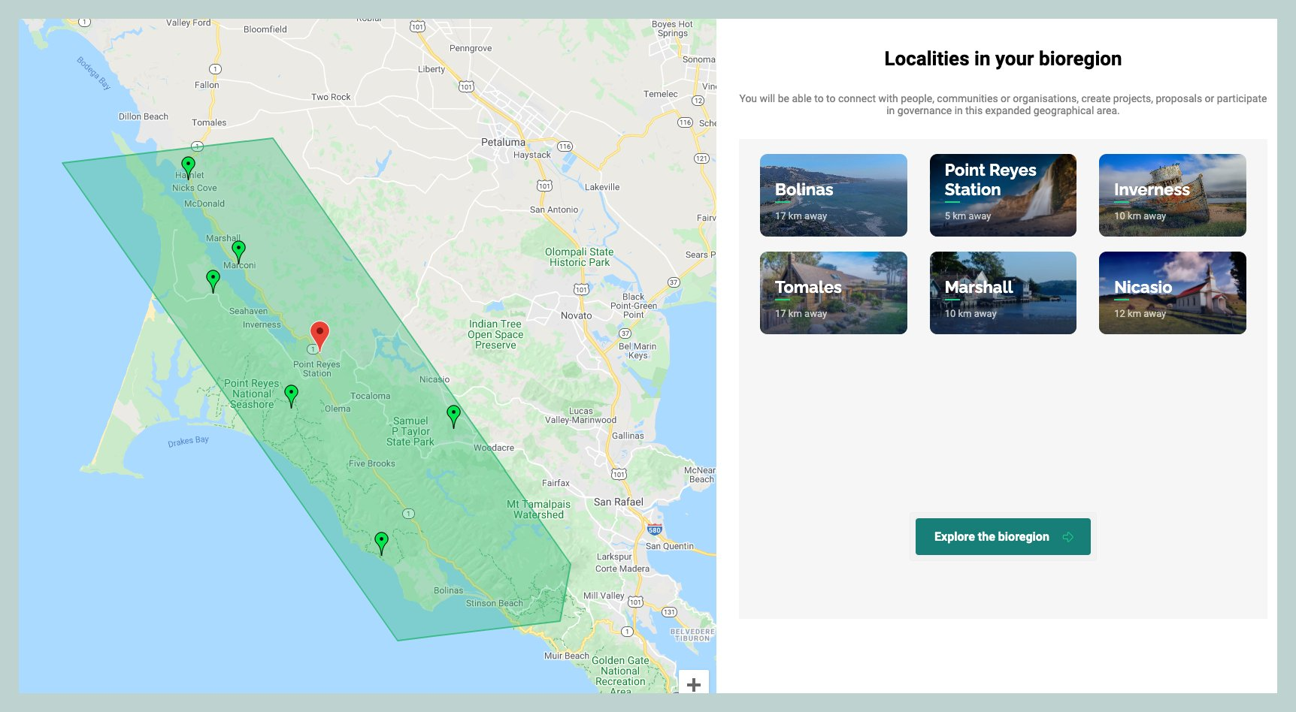
Interconnected Ecosystem of Apps Same accounts - same currency Growing global(regenerative)economy!
Light Wallet
SEEDS Passport
LocalScale Marketplace

Slide 33
















The Decentralized Human Organization
Key functions of the DHO are decentralized payroll and contribution accounting.
Organization
Facet
Sociocratic Circle
Budgeting & Accounting
Role Template
Fractional Assignment
Rewarding & Paying
Bioregional Fractal
Project Contribution
Funding & Distribution
Trial Balloon
Milestone Marker
Granting & Gifting
Work Protocol
Payroll Policy
dPay Governance
Notes:
https://unsplash.com/photos/lbLgFFlADrY
Among the increasing chaos around EIDL && PPP (our U.S. members will know, PPP stands for Payroll Protection Program) I had a few minutes of clarity and made an important connection to Hypha. In recent weeks, I sensed some confusion about what the Hypha DHO is for/what to do there/how to get started. Then it occurred to me that the core function of the DHO is **Decentralized Payroll and Contribution Accounting**. Payroll is a huge chunk of the market and is present in every organization (obviously), but _decentralized_ payroll is just in its baby steps, think about the impact on the currency flows we are beginning to capture here. Similar story about contribution accounting - that's hardly defined but decentralized work in ad-hoc teams around the globe is a big attractor here. Taken together, we can deliver a new kind of function/system (dPay?) that bridges to between the old and the new paradigm. All the other structural elements in the DHO are really secondary to this and provide the necessary _context_ (orgs, circles, bioregions, projects, pilots etc). In addition, Max is doing tremendous work on the (decentralized) treasury and accounting/banking. Just wanted to bounce this back here for further comments.
From Mutual Credit to Mutual Commitment

